Slide 1
K-MEANS ALGORITHM
Sapir Dahan

Slide 2
The Clustering Problem

Slide 3
Let’s Start With 1D

Slide 4
Our Goal Is To Get Best Possible Clustering

Slide 5
The First Step Is To Choose K Centroids At Random Locations

Slide 6
The First Step Is To Choose K Centroids At Random Locations

Slide 7
Calculate The Distance Of Each Object From Each Centroid

Slide 8
Asign Each Object To It Closest Centroid

Slide 9
Asign Each Object To It Closest Centroid

Slide 10
Asign Each Object To It Closest Centroid

Slide 11
Asign Each Object To It Closest Centroid

Slide 12
Asign Each Object To It Closest Centroid

Slide 13
Asign Each Object To It Closest Centroid

Slide 14
Asign Each Object To It Closest Centroid

Slide 15
Find The Mean Of Each Cluster

Slide 16
Reset All Assignments

Slide 17
Repeat Assinments With The New Centroids (New K-Means)

Slide 18
Repeat Assinments With The New Centroids (New K-Means)

Slide 19
Repeat Assinments With The New Centroids (New K-Means)

Slide 20
Repeat Assinments With The New Centroids (New K-Means)

Slide 21
Repeat Assinments With The New Centroids (New K-Means)

Slide 22
Repeat Assinments With The New Centroids (New K-Means)

Slide 23
Repeat Assinments With The New Centroids (New K-Means)

Slide 24
Repeat Assinments With The New Centroids (New K-Means)

Slide 25
Repeat Assinments With The New Centroids (New K-Means)

Slide 26
Repeat Assinments With The New Centroids (New K-Means)

Slide 27
Find The Mean Of Each Cluster

Slide 28
Reset All Assignments

Slide 29
Repeat Assinments With The New Centroids (New K-Means)

Slide 30
Repeat Assinments With The New Centroids (New K-Means)

Slide 31
Repeat Assinments With The New Centroids (New K-Means)

Slide 32
Repeat Assinments With The New Centroids (New K-Means)

Slide 33
Repeat Assinments With The New Centroids (New K-Means)

Slide 34
Repeat Assinments With The New Centroids (New K-Means)

Slide 35
Repeat Assinments With The New Centroids (New K-Means)

Slide 36
Repeat Assinments With The New Centroids (New K-Means)

Slide 37
Repeat Assinments With The New Centroids (New K-Means)

Slide 38
Repeat Assinments With The New Centroids (New K-Means)

Slide 39
If All Items Remain Withing Their Previous Cluster, Then Stop

Slide 40
IS K-MEANS OPTIMAL? NO

Slide 41
IS K-MEANS OPTIMAL? NO

Slide 42
If We Chose Different Initial Random Centroids...

Slide 43
... We Might Get A Different Clustering Arrangement

Slide 44
Definition: Inertia is the sum of squared distance of each object from its centroid

Slide 45
Inertia can be a quality metric for clustering

Slide 46
We can repeat the K-means process multiple times, and select the clustering that has the lowest (best) inertia

Slide 47
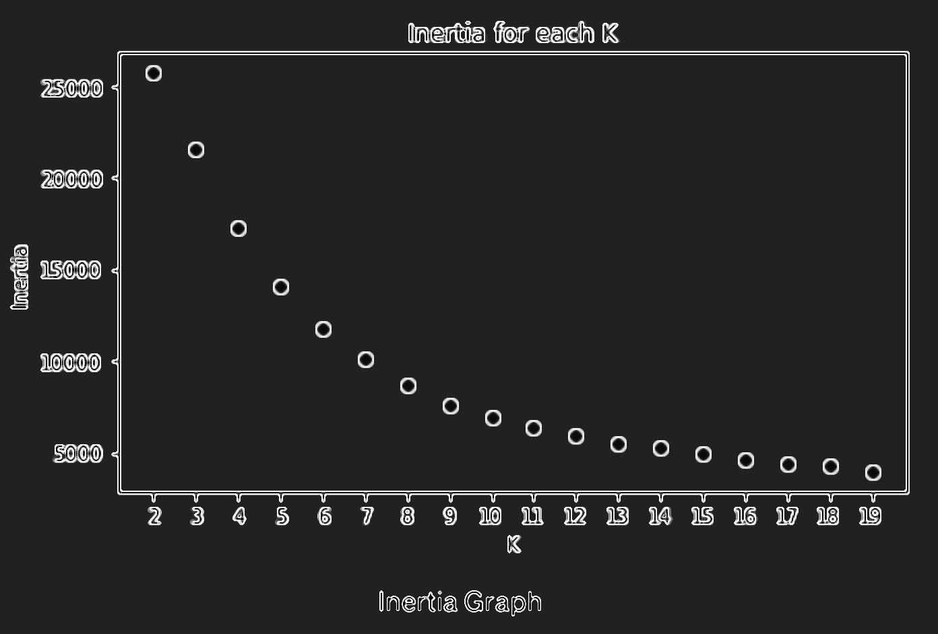
What If We Don’t Know K?
Inertia for each k
Inertia
k

Slide 48
What If We Don’t Know K?
Inertia for each k
Elbow
Inertia
k

Slide 49
We Can Expent The Algorithm To 2D

Slide 50
We Select Random Centroids

Slide 51
Assign Objects To Their Nearest Centroid

Slide 52
Repleat The K-Means Iterations

Slide 53
Stop When All Objects Do Not “Jump” Between Clusters

Slide 54


$$\sqrt{{\text{x}1 }^{2}+{\text{x}\text{2 }}^{2}}$$
x₂
x$1$

Slide 55
Euclidian Distance
$$\sqrt{{\text{x}1 }^{2}+{\text{x}\text{2 }}^{2}}$$
x₂
x$1$

Slide 56




We Can Expend The Algorithm To Any Number Of Dimentions
1D
$\sqrt{{\text{x}1 }^{2}}=$| $\text{x}1$|
2D
$$\sqrt{{\text{x}1 }^{2}+{\text{x}\text{2 }}^{2}}$$
3D
$$\sqrt{{\text{x}1 }^{2}+{\text{x}\text{2 }}^{2}+{\text{x}3 }^{2}}$$
nD
$$\sqrt{{\text{x}1 }^{2}+{\text{x}\text{2 }}^{2}+{\text{x}3 }^{2}+ …+{\text{x}n }^{2}}$$

Slide 57
THANKS FOR LESSINING

